Slide 1


ECHO-SKY
Adaptive Music for every forecast
Python-Project
Music Recommendation System Based on Weather
PRESENTED BY –
04_Devansh Bajaj
09_Meenal Joshi
11_Aanchal Jagga
19_Vaibhav
41_Prerna Sharma

Slide 2


ABSTRACT
The main objective of this project is collecting and analyzing data about the environment along with providing song recommendation using the current weather conditions.
There is a relationship between our mood, and the weather and music that we listen mostly depends on our mood.
Our approach is to develop an automated system to construct a music playlist depending on user mood and specified weather.

Slide 3



TECHNOLOGY STACK
Frontend
Backend
Python Libraries
Tkinter - Used for creating the graphical user interface (GUI), allowing users to interact with the application easily.
API’s - The backend interacts with external APIs to fetch real-time data. 1. Weather API 2. Spotify API
1. Request 2. Pillow 3. Random 4. Web browser

Slide 4

PROJECT FLOW
Weather Data Retrieval
Genre & Artist Mapping
Normalization of Weather Condition
Creating Playlist
Spotify API for song links

Slide 5
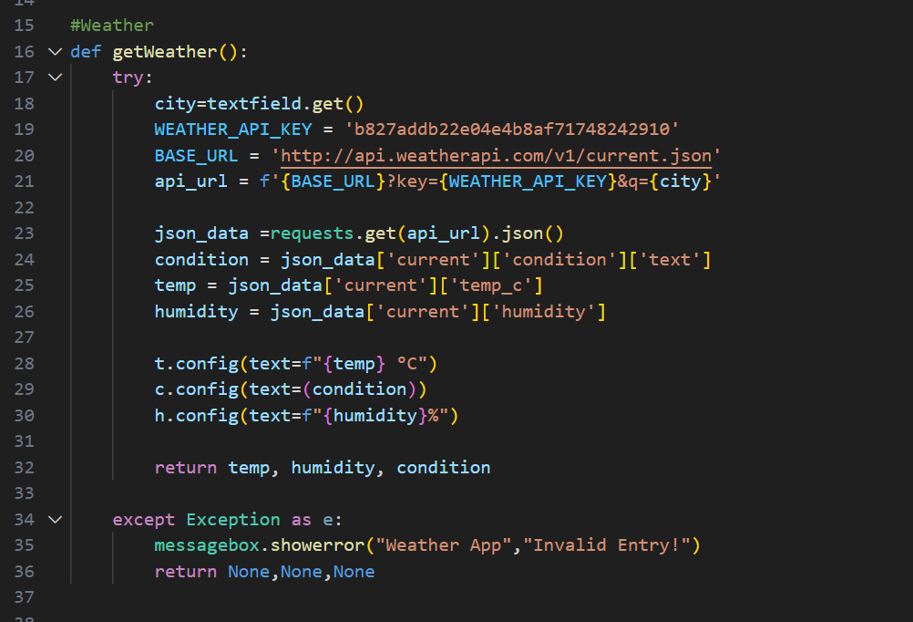
KEY CODE SNIPPETS
Weather Data Retrieval -
This code snippet shows how to fetch and process real-time weather data, extracting key details like temperature, humidity, and conditions, which can be used to create mood-based playlists.

Slide 6
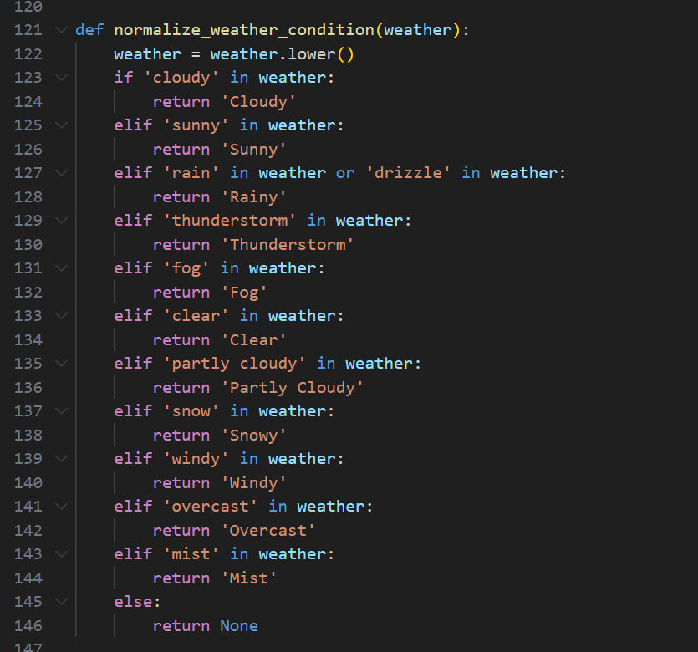
KEY CODE SNIPPETS
Normalization of Weather Conditions -
This snippet categorizes weather conditions into simplified labels like "Sunny," "Rainy," or "Cloudy," which helps in consistently mapping weather conditions to the appropriate music genres.

Slide 7
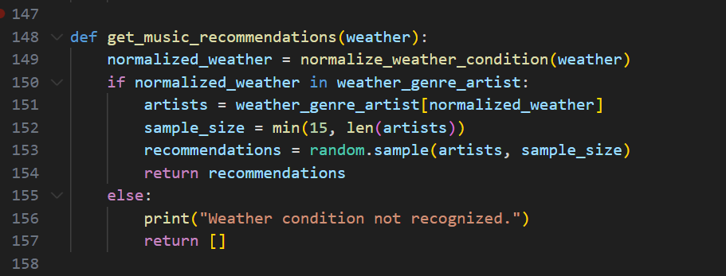
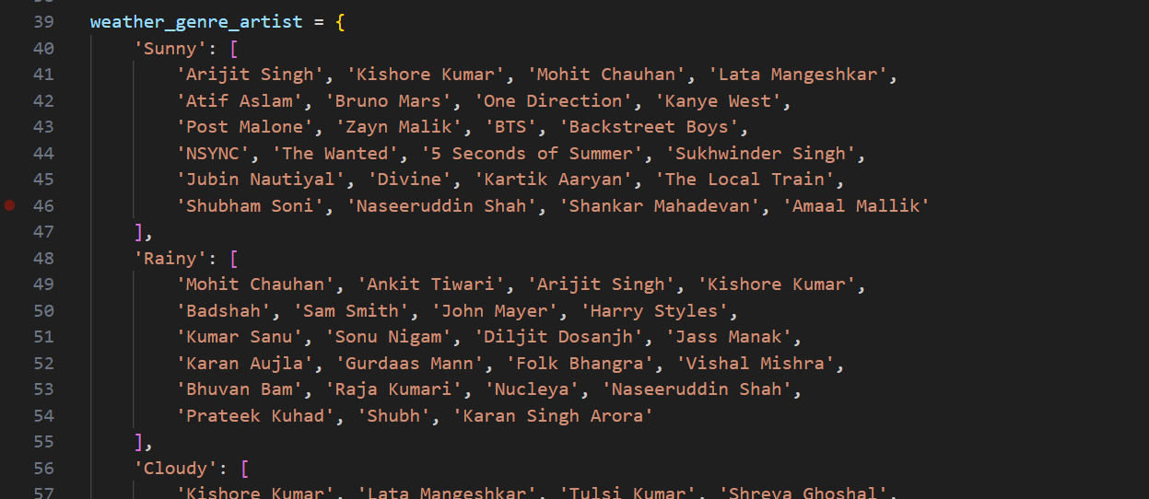
KEY CODE SNIPPETS
Music Recommendation -
This code snippet maps weather conditions to a list of artists and randomly selects a subset of artists for a playlist recommendation based on the current weather.

Slide 8
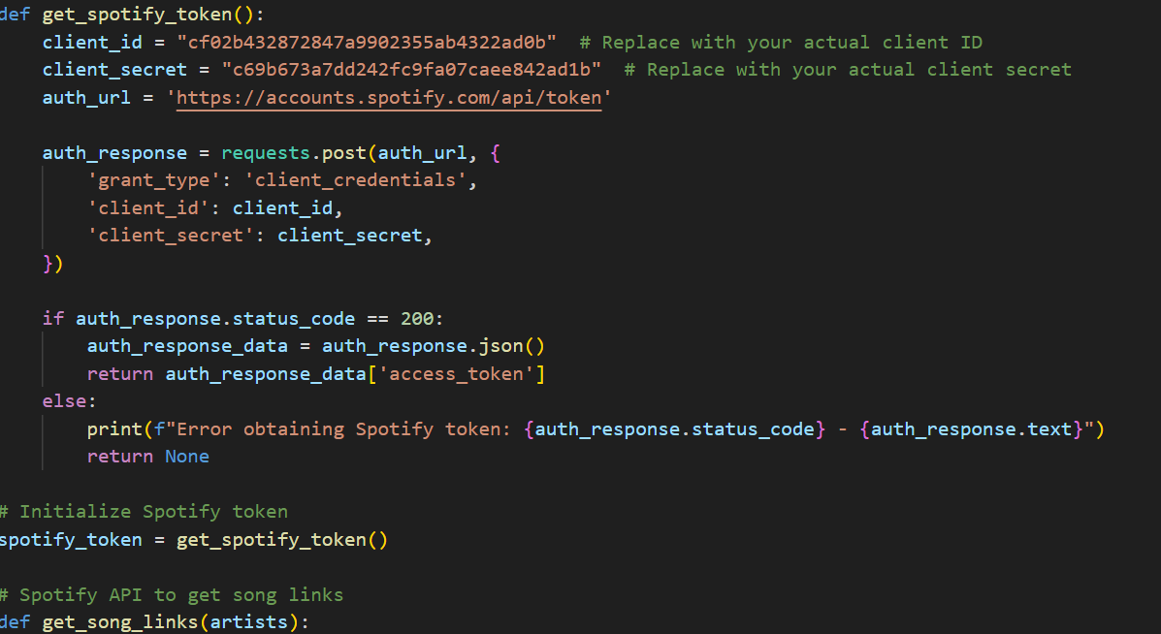
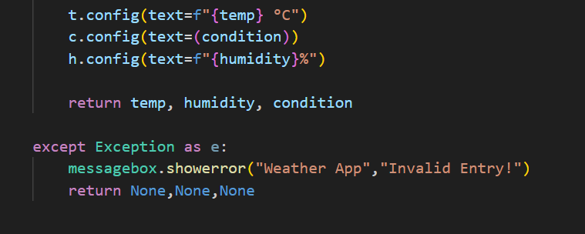
CHALLENGES & SOLUTIONS
Refreshing Spotify Tokens - To maintain Spotify access, an automatic function refreshes the authorization token upon expiration (error 401), ensuring continuous service.
Handling API Errors - To improve user experience, we added error handling for Weather API and Spotify API calls. If an API request fails, an error message is shown instead of crashing the program.

Slide 9
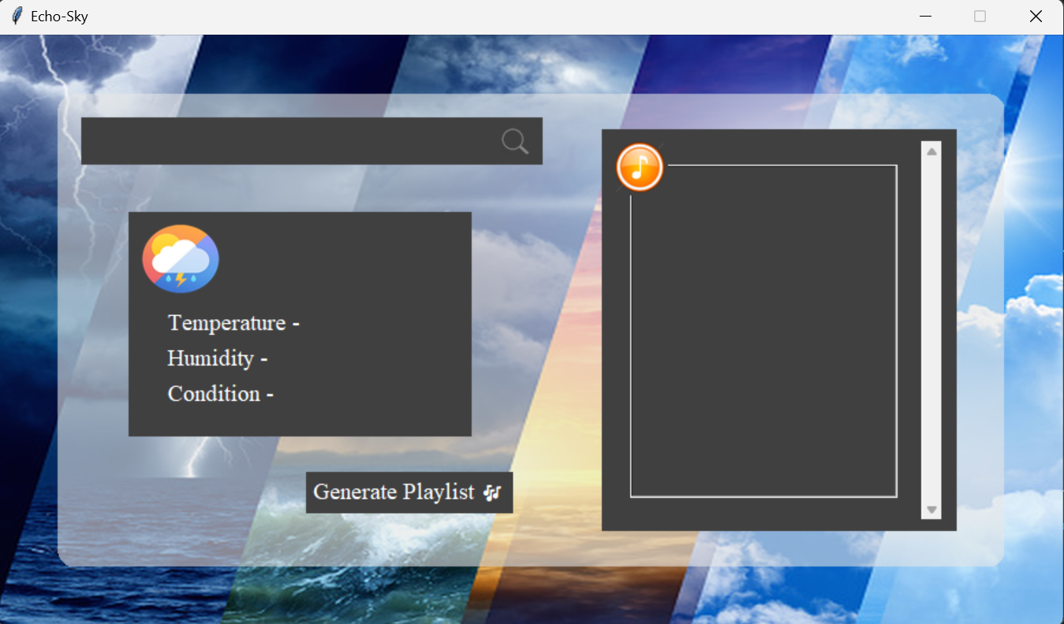
USER INTERFACE DESIGN
Playlist Box
Displays song recommendations.
Weather search Box
Users input their location, and a search icon triggers the weather search.
Weather Display
Shows temperature, humidity, and weather condition.
Playlist Generation Button
Generates a playlist based on the weather data.

Slide 10
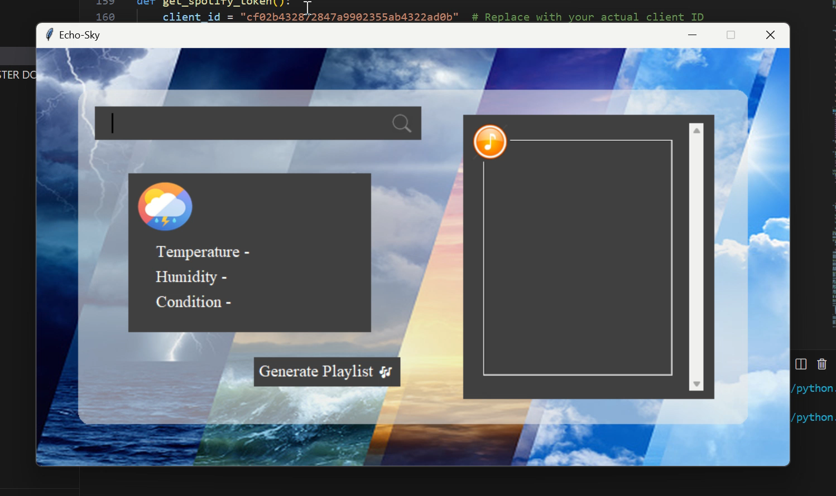
PROJECT FUNCTIONING

Slide 11
CONCLUSION
Echo-Sky leverages real-time weather data to deliver personalized music recommendations, creating playlists that adapt to current weather conditions. By blending weather and music, the application makes song selection more intuitive and relevant, offering a unique listening experience for each user.

Slide 12

Thank You ☺

